Slide 1
Team Case Study: e-Commerce Success of Answers.com
Presenters:
Michael Fetick
Eddie McDowell

Slide 2
Team Case Study: e-Commerce Success of Answers.com We will study the e-Commerce success of the firm Answers.com, with its use of Google AdSense. We will follow how Answers.com managed change to both its business model and technology infrastructure to provide an e commerce solution.

Slide 3
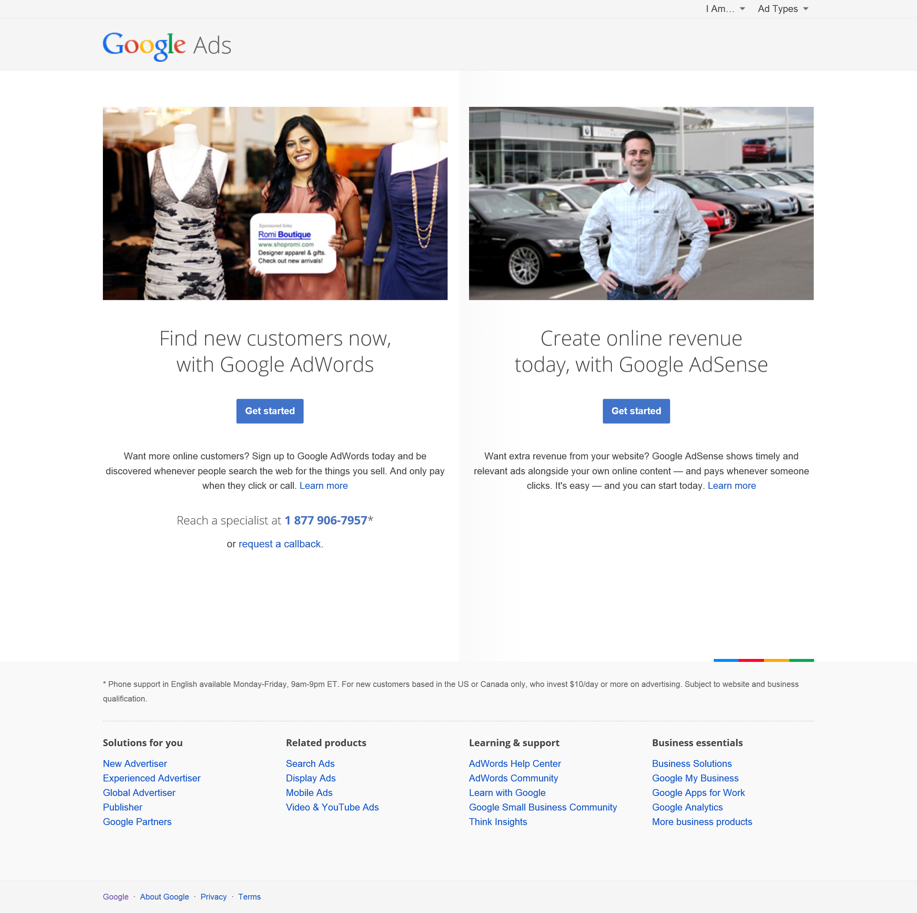
Google AdWords and Google AdSense are acquired at http://www.google.com/ads (Google Inc., 2015)

Slide 4
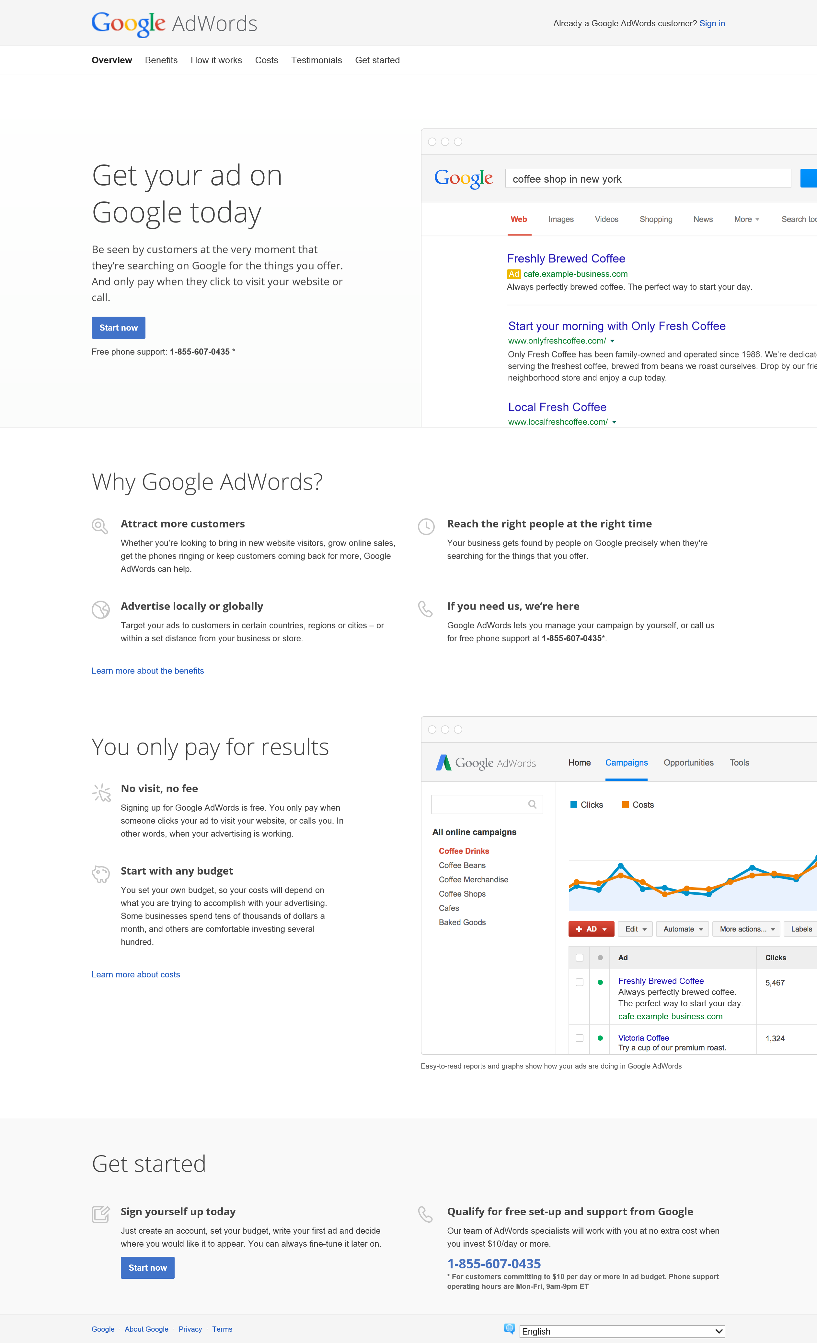
Google AdWords service is Google’s main revenue stream. Marketers bid for keywords on Google’s search engine, for a spot as a related sponsored result. “Be seen by customers at the very moment that they’re searching on Google for the things you offer. And only pay when they click to visit your website or call.” (Google Inc., 2015)

Slide 5
Google AdWords Service
In 2000, advertisers were allowed to bid for placement of short text ads on their search engine results, initially with Goto.com (later Overture). In 2003, Google started its AdWords program on Google search results. Spectacular 20%–25% annual increase in Internet advertising revenues has helped search engines transform themselves into major shopping tools and created a new industry called “search engine marketing. Users enter a search term at Google, Bing, Yahoo and receive two types of listings: - sponsored links, for which advertisers have paid to be listed - unsponsored “organic” search results.
The ‘cost per click’ mechanism is also used by social media platforms such as Pinterest’s Promoted Pins in 2014 and Twitter’s Promoted Tweets. (Google Inc., 2015)

Slide 6
Google AdWords Service
Google has upgraded its AdWords service to the new service, called Enhanced AdWords.
It optimizes ads for user contexts and devices, and to provides management of campaigns across mobile and desktop devices.
For instance, if a customer searches for “pizza” on a desktop PC from work at 1 PM, he or she would be shown restaurants nearby and a quick order form.
If the customer searched for “pizza” at 8 PM on a smartphone within a half-mile of a pizza restaurant, he or she might be shown a click-to-call phone number and directions to the restaurant.
Pizza restaurants pay Google for the chance to show up in these searches.
(Google Inc., 2015)

Slide 7
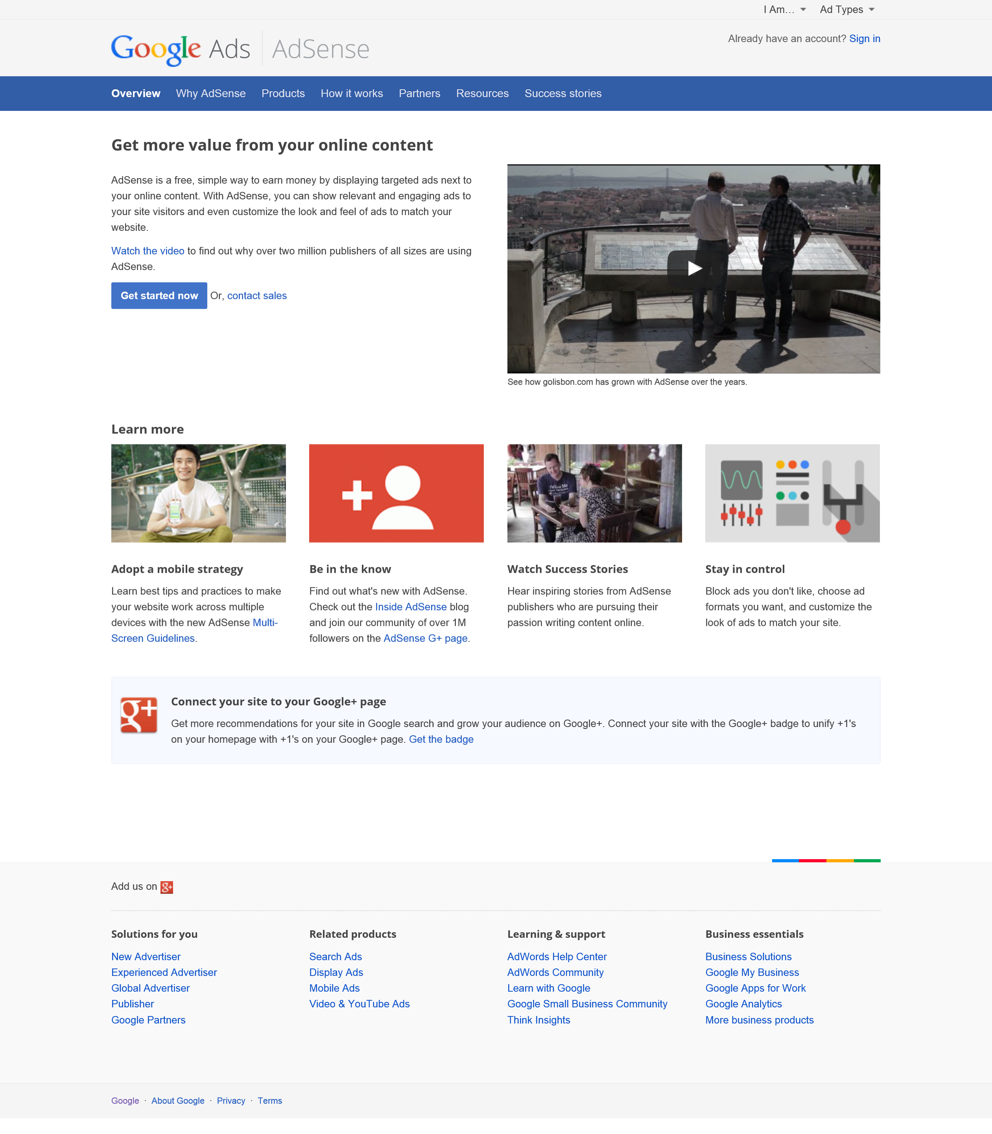
Google AdSense is a free, simple way to earn money by displaying targeted ads next to your online content. You can show relevant and engaging ads to your site visitors and even customize the look and feel of ads to match your website. (Google Inc., 2015)

Slide 8
Google AdSense Service
Bloggers often sign up for Google’s AdSense program to attract advertisers to their sites.
This is affiliate marketing, a form of marketing where a firm pays a commission (typically between 4% and 20%) to other Web sites (including blogs) for sending customers to their Web site.
They are paid for each click on an ad and sometimes for subsequent purchases made by visitors
(Google Inc., 2015)

Slide 9
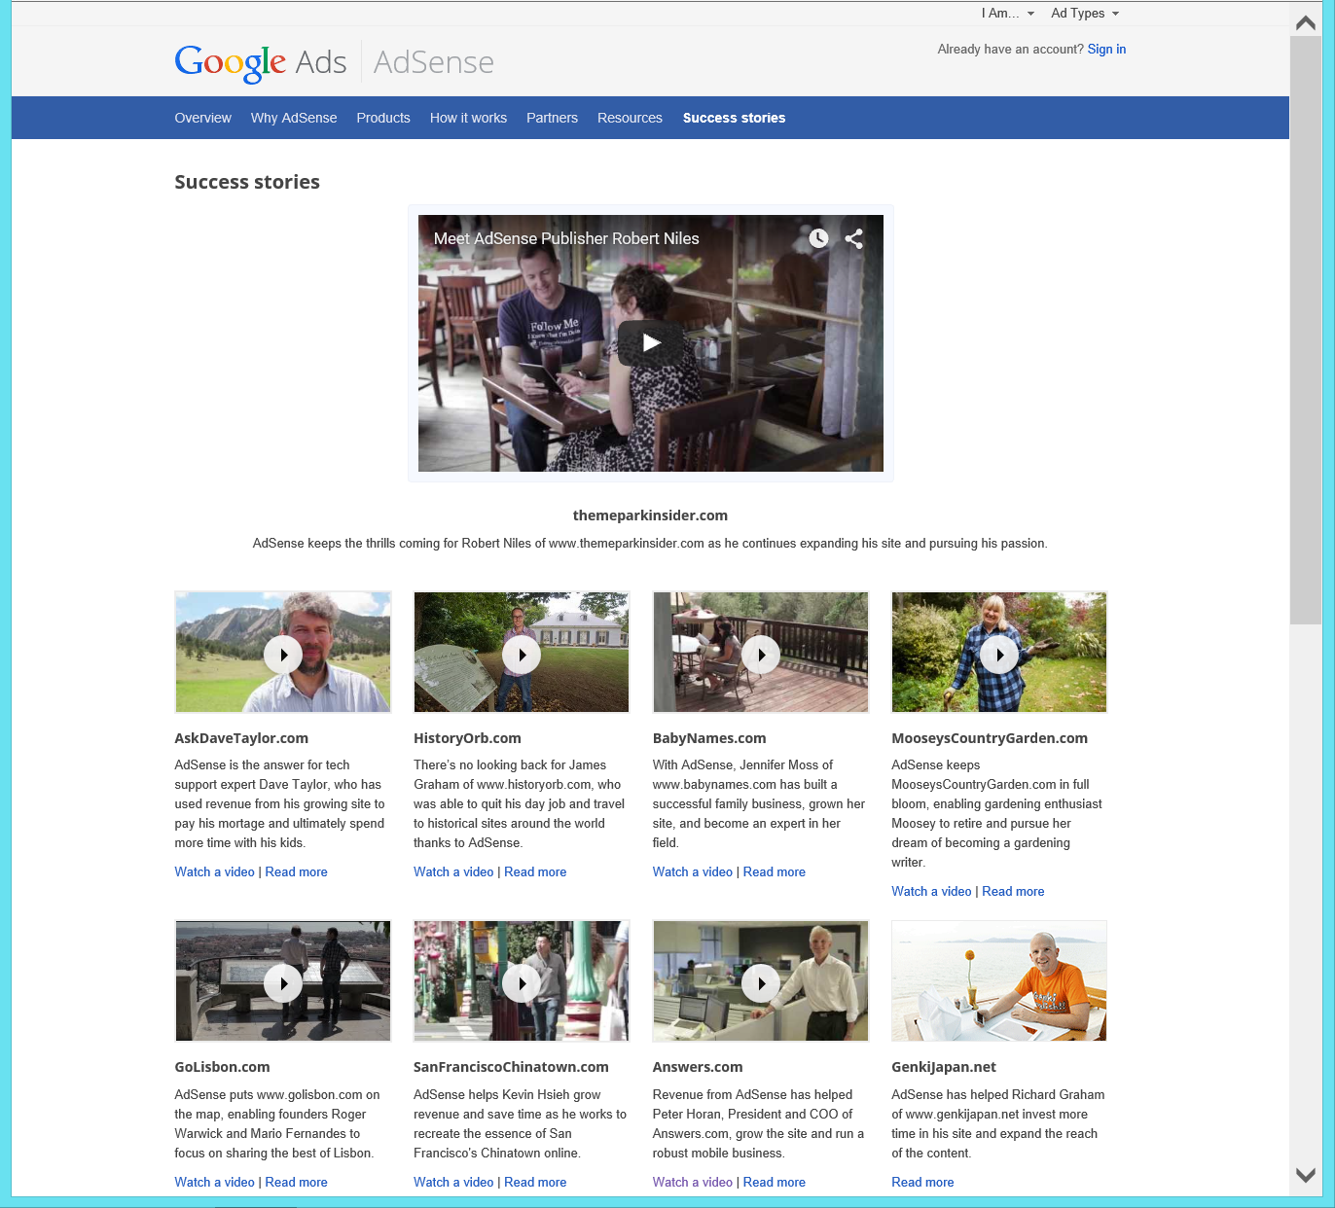
Google Ads – AdSense Success stories Revenue from AdSense has helped Peter Horan, President/COO of Answers.com, grow the site and run a robust mobile business. (Google Inc., 2015)

Slide 10
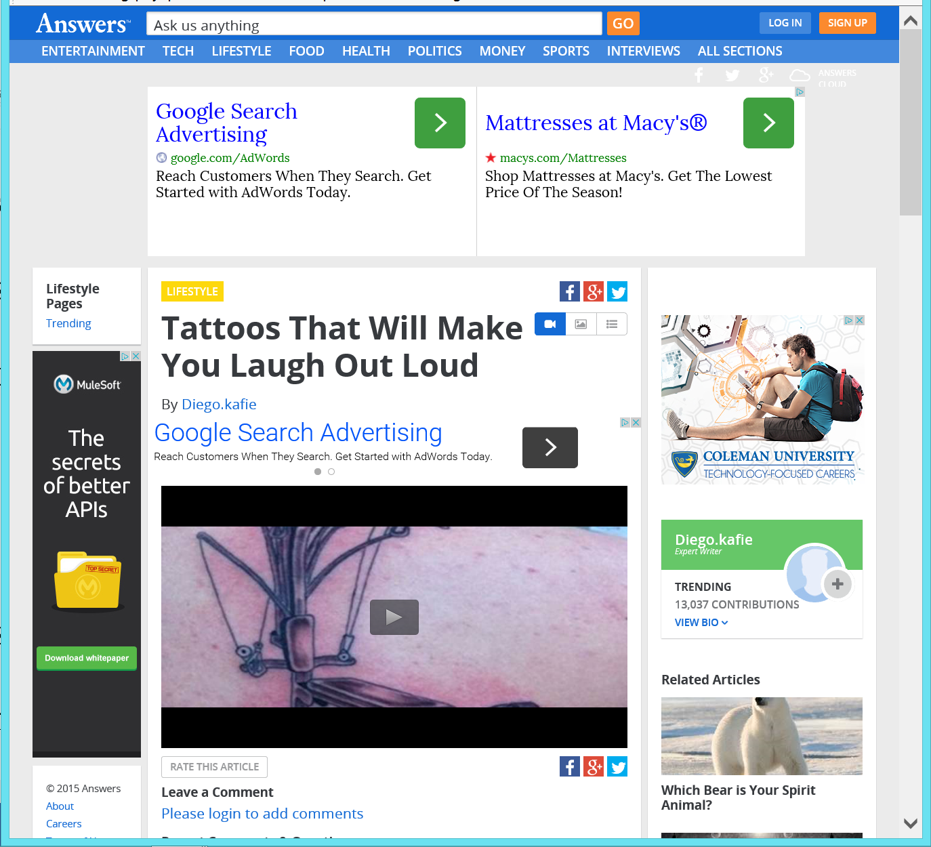
Peter Horan, President/COO of Answers.com says, “AdSense is extremely important to our business. People who come to our site are looking for answers to questions that are typically very specific.” “AdSense presents content that's interesting, relevant and appropriate for our visitors, serving ads that enhance the time the users spend on our site.” (Google Inc., 2015)

Slide 11
“From the publisher perspective, I'm actually earning revenue in a way that improves our users' experience.” “Over the past ten years, I've seen AdSense evolve to meet new challenges. Take mobile, for example: Users are increasingly using their smartphones and tablets to search for information. It's very important for us to provide them with a great experience.” (Google Inc., 2015)

Slide 12
“AdSense has enabled us to have a robust and profitable mobile business that's growing quickly year on year, and to make big bets moving forward through ads that add to our users' experience.” “AdSense provides a bedrock monetization solution for your site, and if your site is growing, then AdSense will grow with you. For our business, there’s nothing as good as AdSense” (Google Inc., 2015)

Slide 13
Google Mobile Ads
Mobile advertising is dominated by Google with an expected $7.1 billion
in mobile ad revenues, constituting about 40% of the entire market.
On the mobile platform, Google is king of search, garnering almost two-thirds of all mobile search ad spending, and expected to total almost $6 billion in 2014.
Google is also the largest distributor of video ads on the mobile platform because of YouTube, and is expected to earn about $1.1 billion in video ad revenues in 2014. Facebook is second with $3.3 billion (18%) of mobile ad revenues, of which over 95% ($3.2 billion) is generated by mobile display ads.

Slide 14
Google Mobile Ads
Google purchased a mobile advertising firm called AdMob in 2009 and claims to be the world’s largest mobile advertising firm for both the Android and Apple’s iOS, operating systems.
App developers use AdMob to provide their apps with consumer and user location information.
Google also sells location information to independent marketing firms. Marketing firms use AdMob to develop full-screen rich media ads.

Slide 15
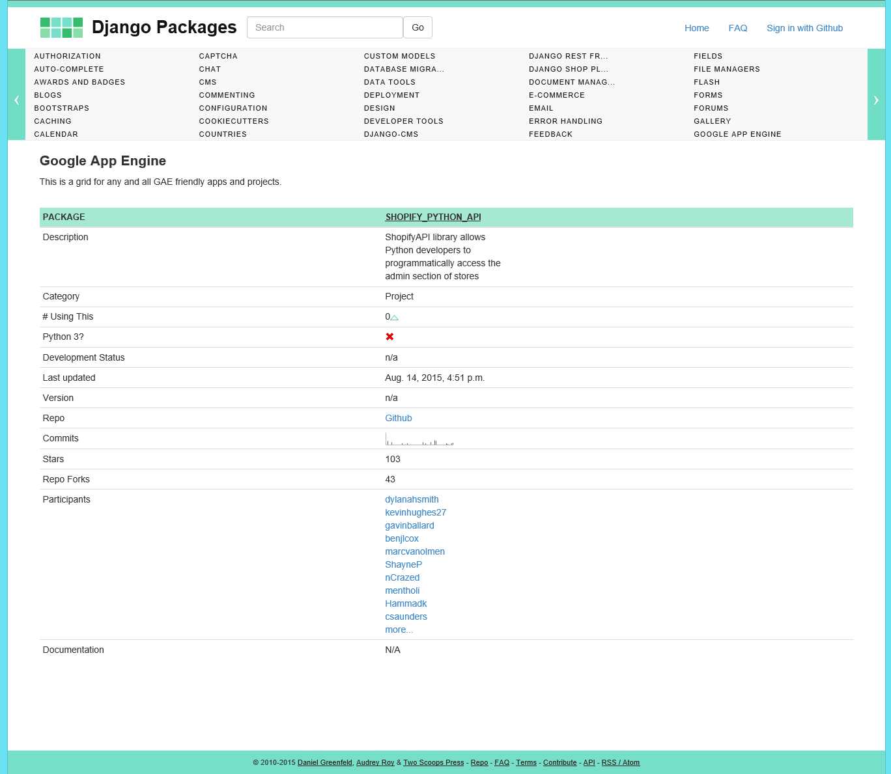
Google’s Innovations and Technologies
The Google Application Engine (GAE) is used to develop, deploy, and distribute mobile apps for the Android smartphones. GAE is ‘open source’ software code to allow software developers to use it in their products.
One example is Python’s Django packages for frameworks that use the GAE to develop the Shopify Python API:

Slide 16
Google’s Innovations and Technologies
Google is developing many technologies, primarily starting with the Google search engine, there also are:
Google Maps,
Google Analytics,
Google Play (Store),
Web Services,
Google Glass,
Drones,
Project Loon,
Google Chrome,
etc.
These and other technologies may converge in the future into more powerful products.

Slide 17
Conclusion Team Case Study: e-Commerce Success of Answers.com Answers.com uses AdSense to have a robust and profitable mobile video ad business. Other Google technologies are converging to possibly approach an ‘enjoyable user experience’ while viewing ads. The recent development of Apple’s next mobile browser to allow users to reduce ads – will be interesting. I believe it’ll be a market shake-out. To compete with a ‘no ads’ user experience may require an ‘enjoyable user experience’ with ads. Sometimes on TV, I like the commercials better than the TV show. And this may be the case with mobile ads in the future.

Slide 18
References Team Case Study: e-Commerce Success of Answers.com Google Inc. (2015, Sep 28). Google Ads. Retrieved from Google: http://www.google.com/ads/ Horan, P. (2015). Peter Horan, President and COO of Answer.com. (Google, Interviewer) Laudon, K. C., & Traver, C. G. (2015). E-commerce 2015. Business. Technology. Society. 11th Edition. Pearson Education, Inc. Django Packages (2015, Sep 2). A directory of reusable apps, sites, tools, and more for your Django projects. Retrieved from https://www.djangopackages.com/grids/g/google-app-engine/

Slide 19

Team Case Study: e-Commerce Success of Answers.com

